Slide 1
Parallel implementation of selected HTM components

Slide 2
Understanding HTM
Hierarchical Temporal Memory
Improve existing learning algorithms
Neural network with feedback signal
cells-->columns-->regions(layers)
Learn -> infer-> predict
Learning(spatial pooler+temporal pooler)= establish connections->update permanence values

Slide 3
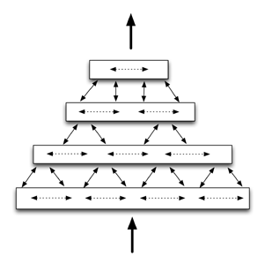
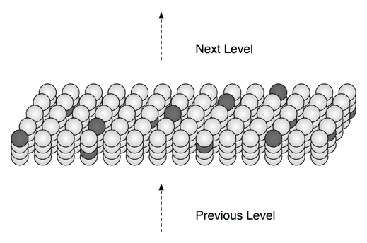
HTM Structure

Slide 4
Understanding HTM(contd...)
Spatial Pooler:
feed forward connections between i/p bits and columns
Activates a set of columns based on given input
Determine how many valid synapses are connected to active bits
Column with highest number of activations in the past inhibits the others
Gives sparse representation of active columns

Slide 5
Understanding HTM(contd…)
Temporal Pooler:
Learns connections within a region
Represent the active cells in context of previous input
Determine the cells in predictive state
Update permanence values of those cells(temporary)
Cell switches from inactive to active- update permanence only if correctly predicted
Cell changes from active to inactive-undo the temporary changes in permanence.

Slide 6
The Parallella Board
Epiphany-16 core microprocessor (3rd gen)
32-bit float point support
1 GB RAM
C/C++ programmable
32-bit address space
support for parallel computing

Slide 7
Implementation approach
Object oriented design
memory provided by parallella
Challenge: How to modify the algorithms for parallel implementation?
Current Status: Working towards implementation of distributed sparse representation of input bits--initial step to learning process

